Slide 1
JAVA PROJECT
SIMULATION OF CAR CHARGING STATIONS
-TEAM#10
Team Members
Krithika Premkumar (7218970)
Akhilesh Kakkayamkode (7218923)
Akhil Narayanaswamy (7219528)
Vipin Krishna Vijayakumar (7219307)

Slide 2
AGENDA
Problem Statement
Approach
Code Overview
User Interaction
Unit Testing
Future Enhancement

Slide 3
PROBLEM STATEMENT-KEY REQUIREMENTS
1.Multiple Charging Stations
2.Multiple Cars at Random Intervals
3.Energy Management System
4.Logging of data
5.Access to data

Slide 4
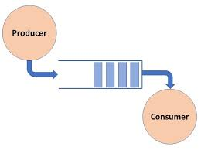
APPROACH Multi Threading
-Producer: Cars are produced at random intervals
-Consumers: Charging Stations support charging of cars simultaneously
-Cars in the charging station either charge concurrently
-Wait for a slot concurrently
-Shared Resource : Array List with Cars added

Slide 5
APPROACH Producer
Functionality: Produce cars at random intervals
Realisation:
Use of random function for generating a random sleep time to create a real world scenario of random arrival of cars
Adding cars to an Array List by making use of the add method

Slide 6
APPROACH Shared Resource
Functionality: To provide a pool of cars from which the charging station threads remove the cars for charging
Realisation:
-Add method is defined to get a car added to the list
-Remove method is defined to remove a car added to the list

Slide 7
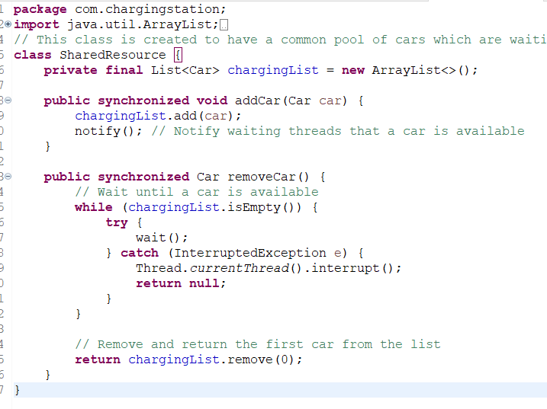
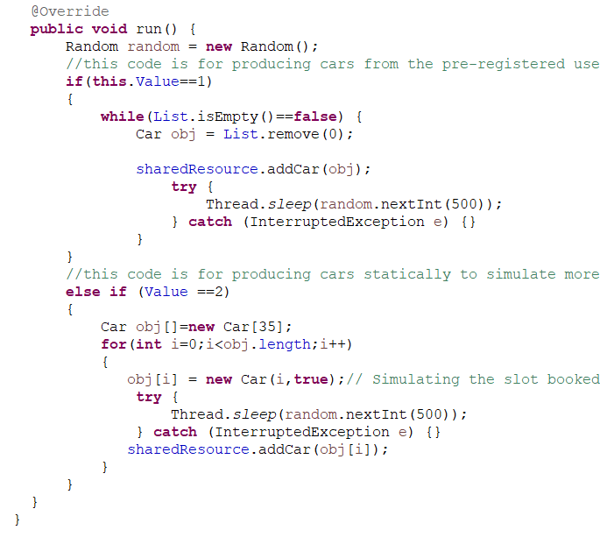

Slide 8
APPROACH Charging Station
Functionality: Charging of the cars concurrently or facilitating waiting of a car
Realisation:
- Using the remove method to remove the Car information from the List.
- Using synchronized blocks to avoid data inconsistencies of shared data between the cars like slot availability, available charge in the station.
-Using Thread sleep method to simulate charging conditions
-Using wait&notify method in threading to simulate waiting for a slot and occupying a slot when available
-Adding the car back to the queue if not charged because of long waiting

Slide 9
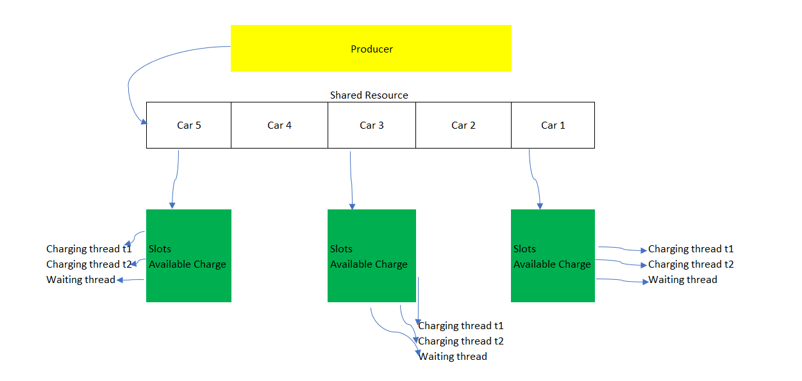

Slide 10
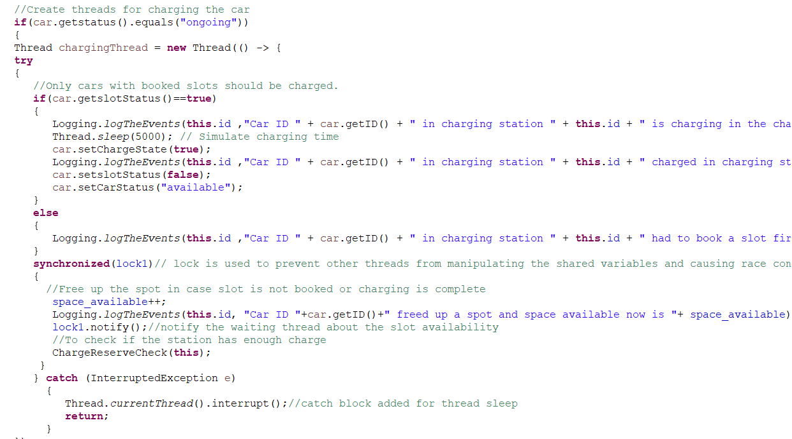
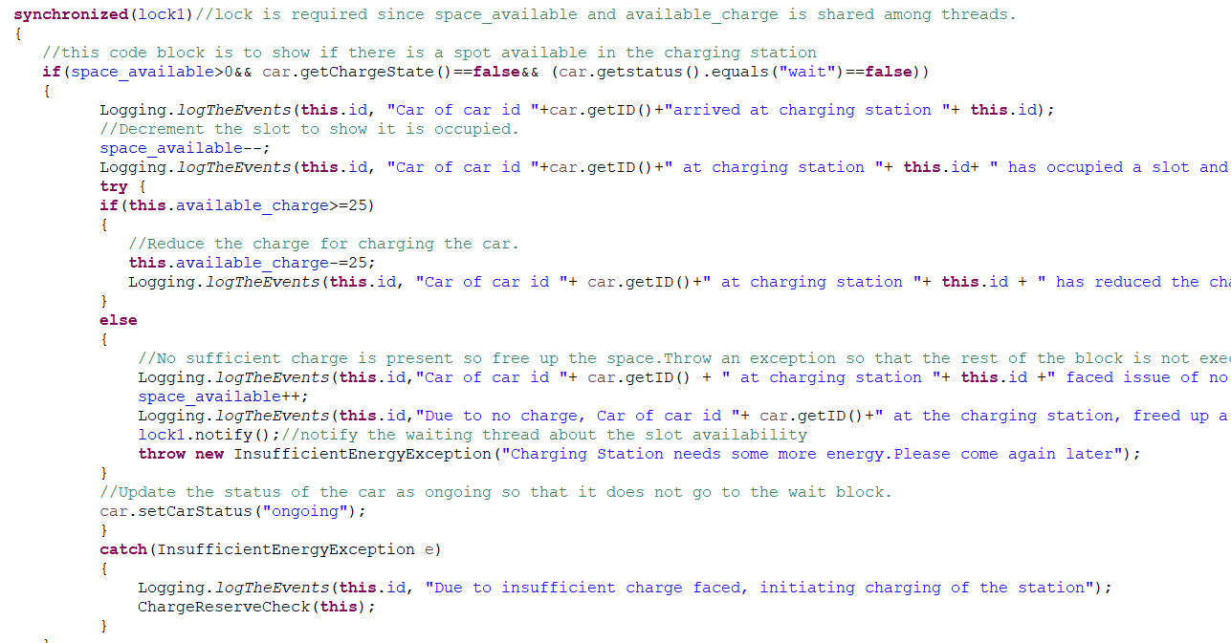

Slide 11
APPROACH
ENERGY MANAGEMENT SYSTEM
SUNNY
SOLAR
WINDY
WIND
Energy Sources
Weather Conditions
RAINY
GRID
OVERCAST

Slide 12
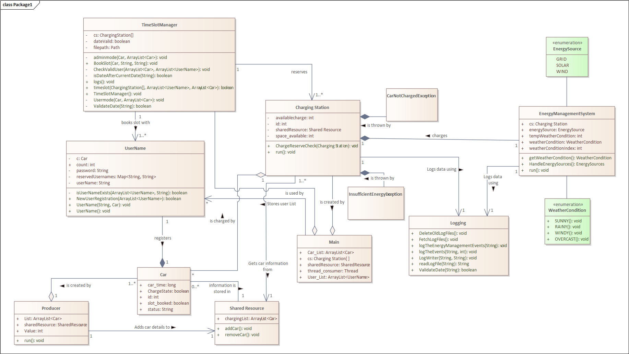
Class Diagram

Slide 13
CODE OVERVIEW Key Classes
The Main class is the entry point of the program; initializes necessary components.
The UserName class handles the user registration process and validates user input.
The TimeSlotManager class manages time slots and validates user input for time slot booking.
ChargingStation class is responsible for charging the cars.
Producer class is responsible for producing the cars.
EnergyManagementSystem class manages the energy source to be used for charging the station.
Logging class enables the logging of data to different log files and access to the data based on the provided inputs.

Slide 14
CODE OVERVIEW
EnergyManagementSystem Class
Dynamically chooses between SOLAR, WIND, or GRID energy sources based on current weather conditions to optimize charging efficiency.
Employed threading to execute the Energy Management System concurrently, enabling simultaneous management of multiple charging stations for enhanced responsiveness.
Synchronized blocks, are used to ensure safe access to critical operations like updating charge availability, preventing potential data corruption across multiple threads.

Slide 15
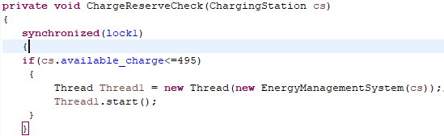
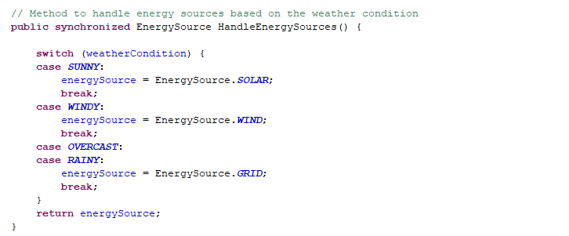

Slide 16
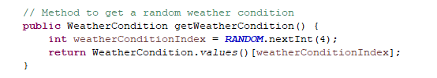
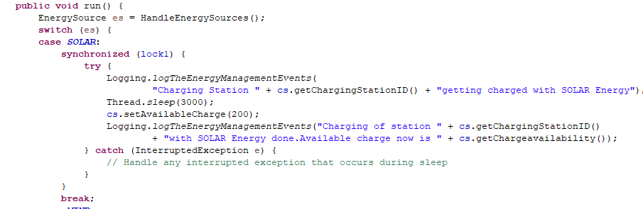

Slide 17
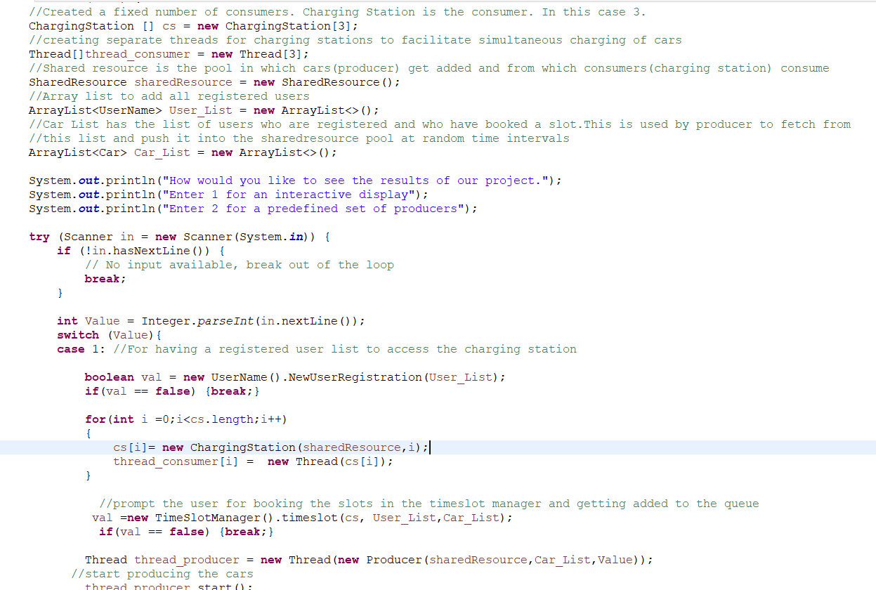
CODE OVERVIEW
Main Class
Manages user interaction to select between interactive or predefined modes.
Creates instances of charging stations and shared resources required for the predefined modes

Slide 18
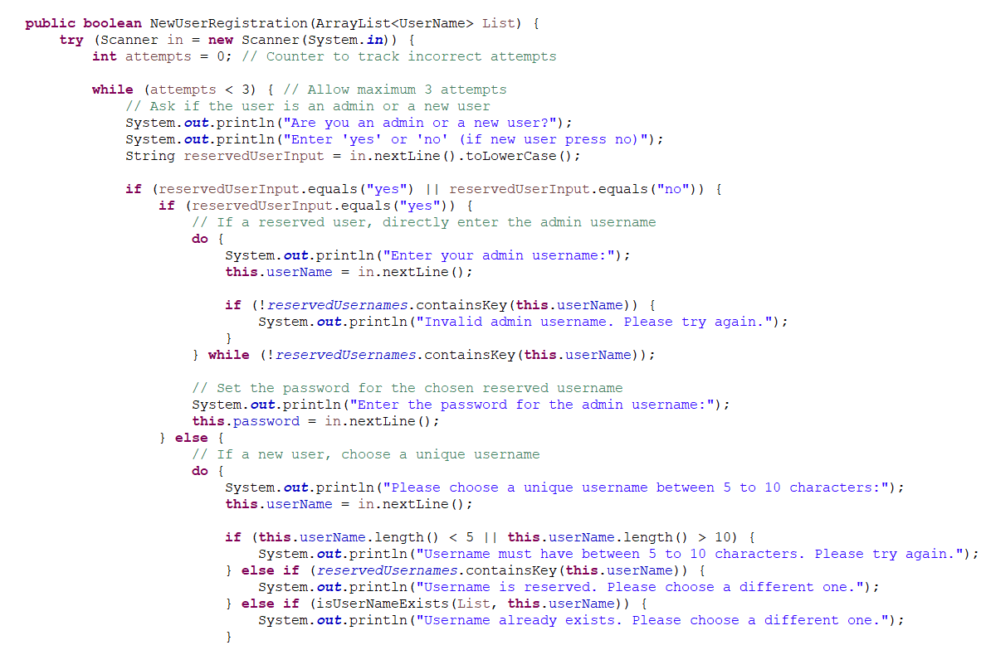
CODE OVERVIEW
User Name Class
Facilitates the user registration process.
Validates the username and password.
Users can create unique IDs to the users.

Slide 19
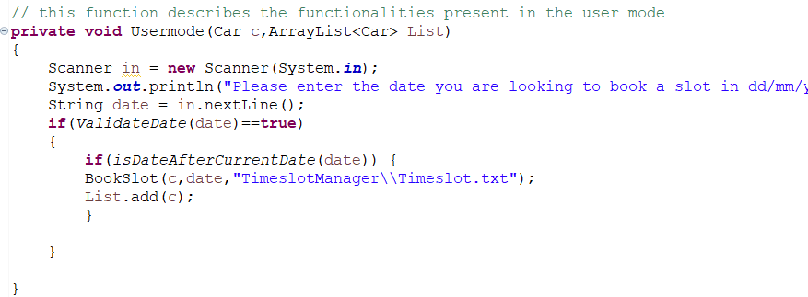
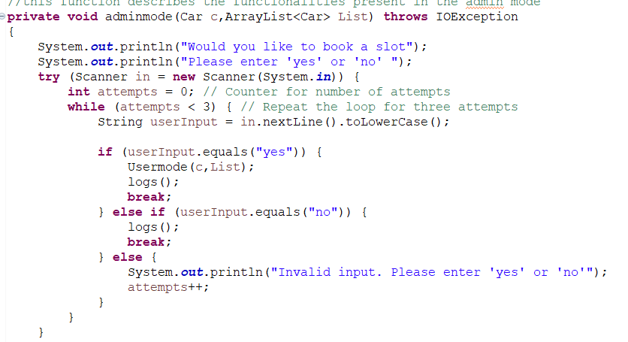
CODE OVERVIEW
Timeslot Manager Class
Manages time slot allocation for charging stations.
Validates user input for time slot booking.
Provides functionalities for user and admin modes.

Slide 20
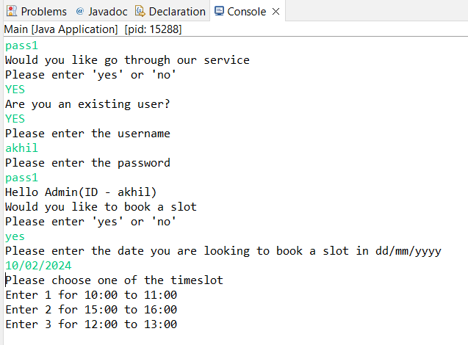
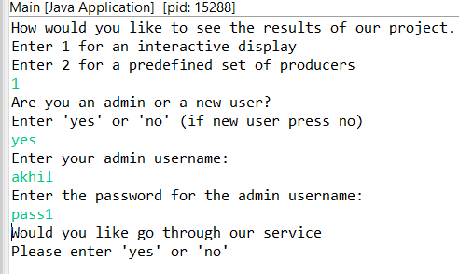
CODE OVERVIEW
User Interaction
User registration involves entering a username, password, and validation.
Time slot booking includes selecting a date, time slot, and confirmation.

Slide 21
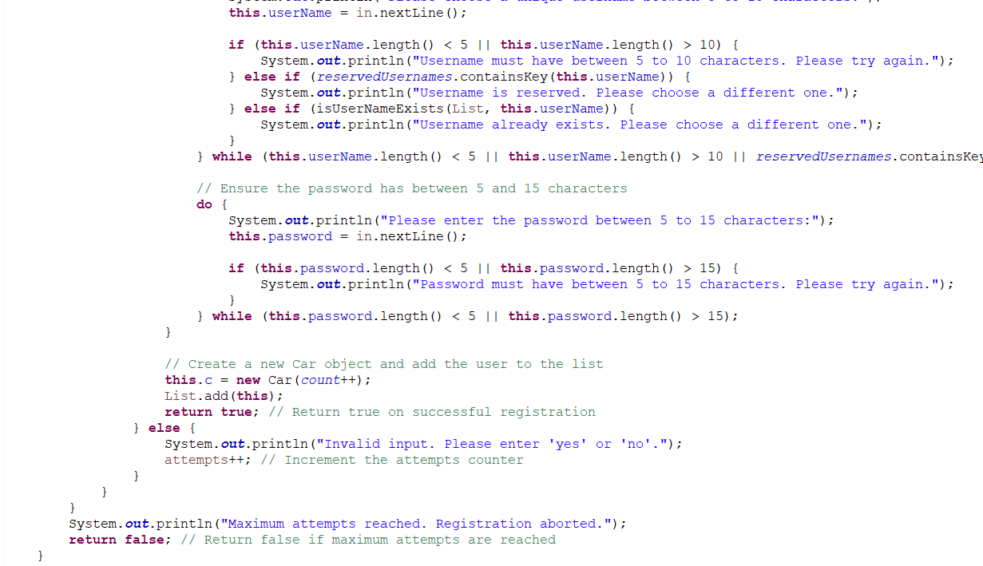
CODE OVERVIEW
User Interaction Error Handling
Limits the number of attempts at user interaction to prevent abuse.
Validates date and password inputs to maintain data integrity.

Slide 22
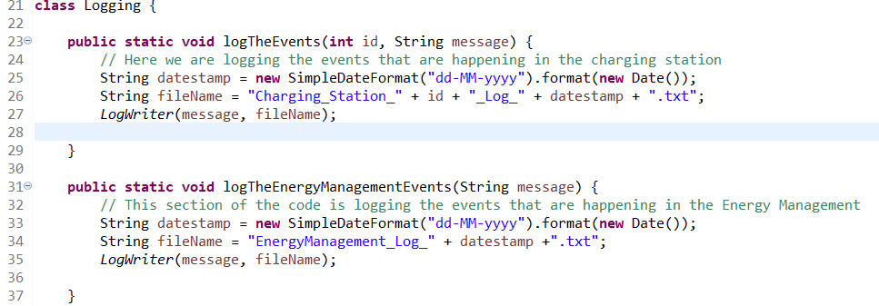
CODE OVERVIEW
Logging Class
Logs the Events at Charging Station and Energy Management
Events will be logged to files with Timestamp and UserId
Provides functionalities for Reading the files from admin mode and Deleting the old files
Using regex pattern to get input from user and identify the file requested.

Slide 23
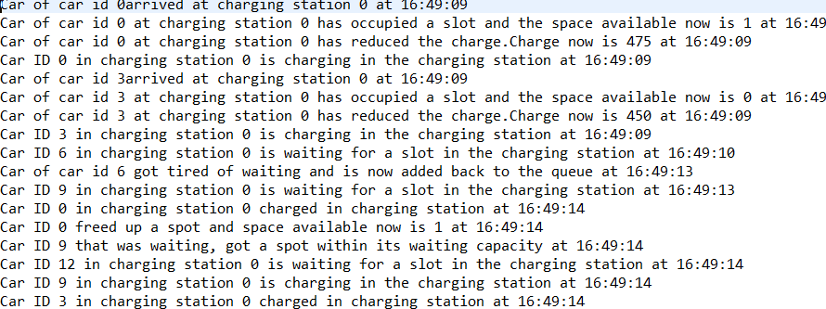

Slide 24
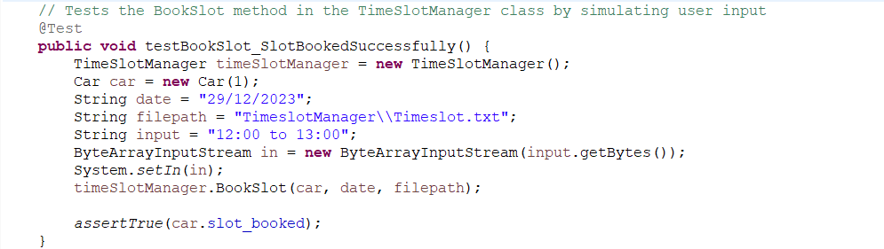
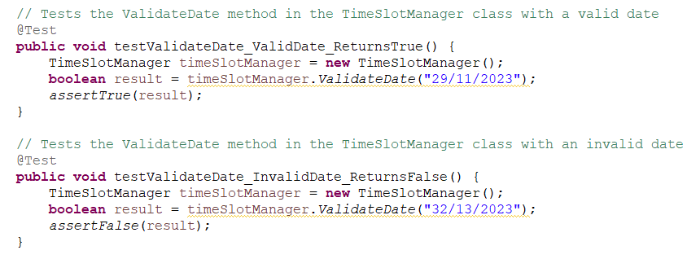
UNIT TESTING
Unit testing is done using Junit to ensure the output for different inputs are as per expectation.

Slide 25
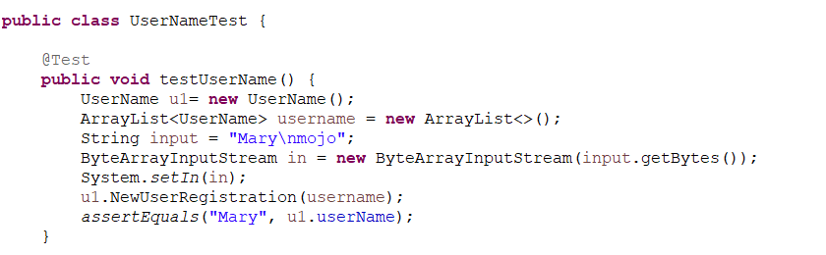
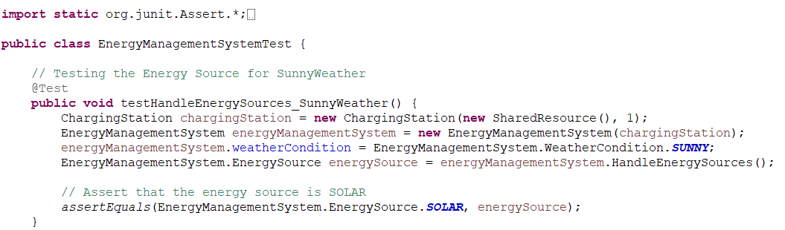
UNIT TESTING
Unit testing is done using Junit to ensure the output for different inputs are as per expectation.

Slide 26
FUTURE ENHANCEMENT
Expansion of admin functionalities to provide more control and insights.
Implementation of advanced error handling mechanisms for improved user experience and system reliability.
To predefine which charging station the user wants to go to and assign that to the user.

Slide 27
THANK YOU!

